Slide 1
How to Properly Wear a Face Mask
Nurse Andrea

Slide 2
What is COVID-19?
Coronavirus disease 2019 (COVID-19, SARS-CoV-2)
respiratory illness that can spread from person to person
Through close contact- within 6 feet of another person
Through respiratory droplets in the air when an infected person coughs or sneezes
By touching a surface or object that has the virus on it and then touching your mouth, nose, or eyes

Slide 3
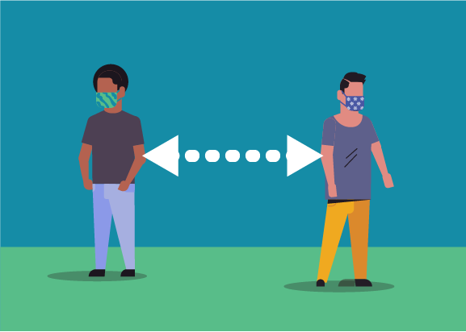
Follow everyday health habits!
Handwashing- wash often, with soap and water
for at least 20 seconds each time
Use hand sanitizer when not available
Social Distancing- stay at least 6 feet away from others
Avoid contact with people who are sick
Wearing a mask- today we will focus on this!

Slide 4
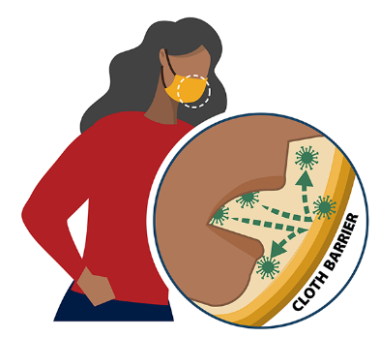
Why we wear a mask
Droplets are released into the air when someone talks, coughs, sneezes, or raises their voice
Masks are worn as a barrier to help prevent respiratory droplets from traveling into the air and onto other people
Source Control
Masks reduce the spray of droplets when worn over nose and mouth

Slide 5
Wear mask in public settings and when around people who don’t live in your household
When social distancing measures are difficult to maintain
Here at school
Your mask may help protect others, their mask might help protect YOU!

Slide 6
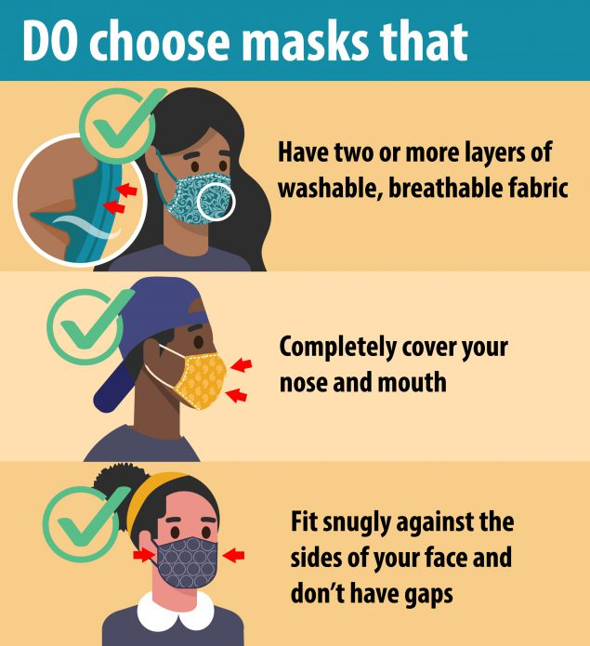
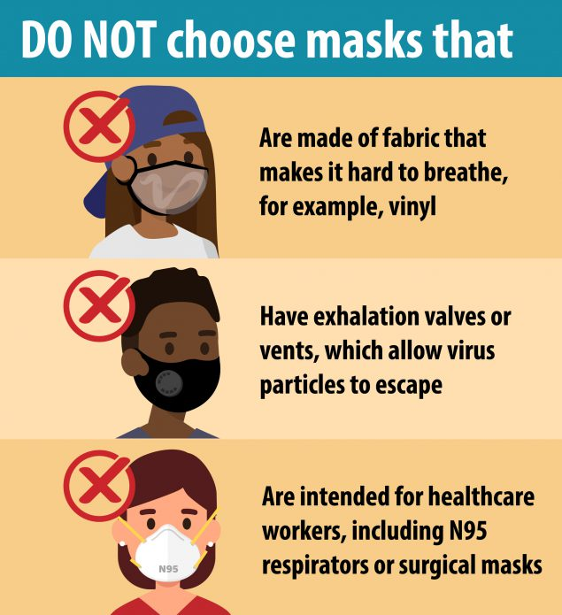
How to select a mask

Slide 7
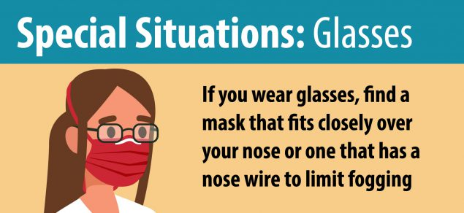

Slide 8
Wear your mask correctly
Wash your hands before putting on a mask
Wear a mask correctly and consistently for best protection
Wear a mask that covers your nose and mouth and secure it under your chin
Fits snugly against the side of your face
Make sure you can breathe easily
Do not touch the mask while wearing it- if you do wash your hands or use hand sanitizer to disinfect

Slide 9
How to wear a mask

Slide 10
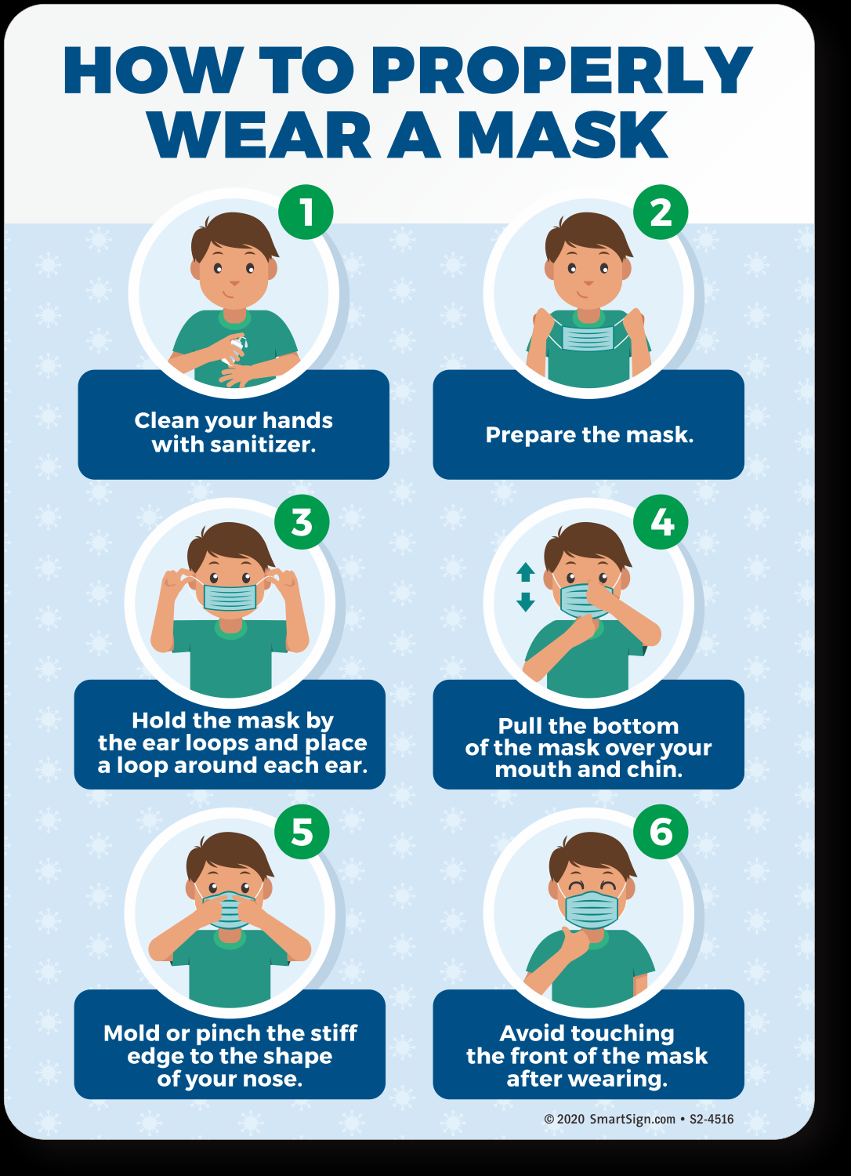

Slide 11
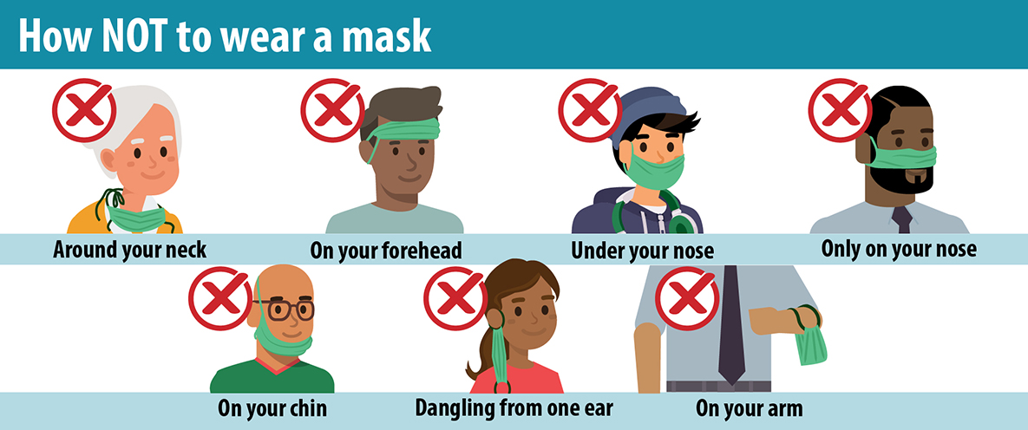

Slide 13
Handwashing- a review!
Wet hands with water
Apply enough soap to cover all hand surfaces
Rub hands together and scrub everywhere for at least 20 seconds
Wash the front and back of your hands, in between your fingers, and under your nails.
Rinse hands with warm water
Dry hands completely using a single use towel or air dry
https://youtu.be/OZ3oSvfiwU4?t=9

Slide 14
Putting it all together… Your turn!

Slide 15
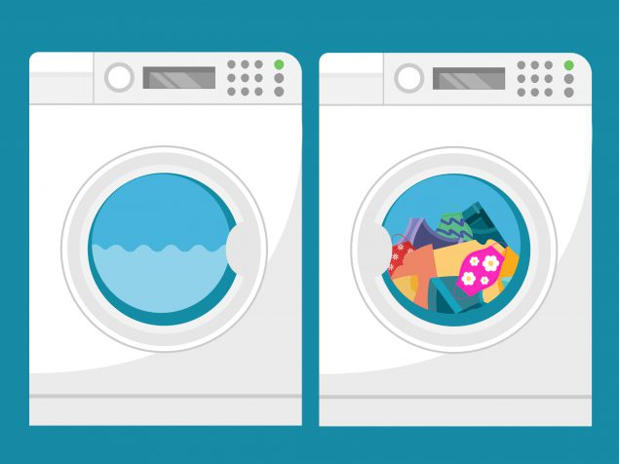
How to clean masks
Masks should be washed regularly
Include mask with your regular laundry
Use regular laundry detergent and warmest appropriate water setting for cloth used to make the mask
Drying
Dryer-Use the highest heat setting and leave in the dryer until completely dry
Air Dry- Lay flat and allow to completely dry. If possible, place mask in direct sunlight

Slide 16
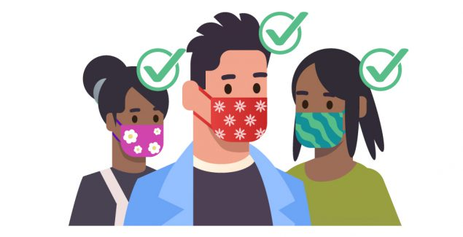
Any Questions??

Slide 17
References
Centers for Disease Control and Prevention. (2019, October 8). Handwashing - Clean hands
save lives. https://www.cdc.gov/handwashing/index.html.
Centers for Disease Control and Prevention. (2020a, June 16). How COVID-19 spreads.
https://www.cdc.gov/coronavirus/2019-ncov/prevent-getting-sick/How-covid- spreads.html
Centers for Disease Control and Prevention. (2020b, August 7). Considerations for wearing masks. https://www.cdc.gov/coronavirus/2019-ncov/prevent-getting-sick/diy-cloth-face- coverings.html
Hartman, J. (2019, November 26). Learn how to wash your hands song [Video]. YouTube.
https://www.youtube.com/watch?v=OZ3oSvfiwU4
Pennsylvania Department of Education. (2020, July). Answers to FAQs: Universal face coverings order. https://www.education.pa.gov/Schools/safeschools/emergencyplanning/COVID-19
Waivers/MaskWearing/Pages/default.aspx

